Slide 1
Final Fantasy Game
By Kai Hedrick

Slide 2

Introduction
“Welcome to the game!”
“This is a rpg medieval game where you have to progress and defeat the enemies that took over a nearby town.”

Slide 3
Load character
Uses load function.
Ability to load a character (optional) or create a new game.
If creates a new game, the class choices are warrior and archer.

Slide 4
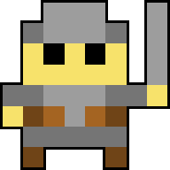
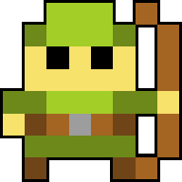
Classes
Each class has there own abilities. Archer has range, and warrior has dexterity.
The two different abilities will allow each class to be unique in their own way.
Each class has their own weapons as well.
The stat info will be displayed before entering the game.

Slide 5
Dialogue
You will meet a character who tells you about the game and the objective.

Slide 6

First fight
The first fight you will encounter a minion who should generally be a easy target to kill. The minion should drop loot in the form of gold for the player to aquire which the player will be able to use.

Slide 7





store
The player will be able to go to the store.
The stores items are unique to the player’s class.
There will be a selection of bows, and swords.
One of the items is a potion that will heal the players health.

Slide 8
Final boss
The final boss is a dragon which has different abilities that will damage the players health faster. Once defeating the boss the game will output final dialogue saying “You beat the game congrats!”.

Slide 9
References
Used sprites for items from a game called ROTMG
Dragon is from Minecraft

